Slide 1
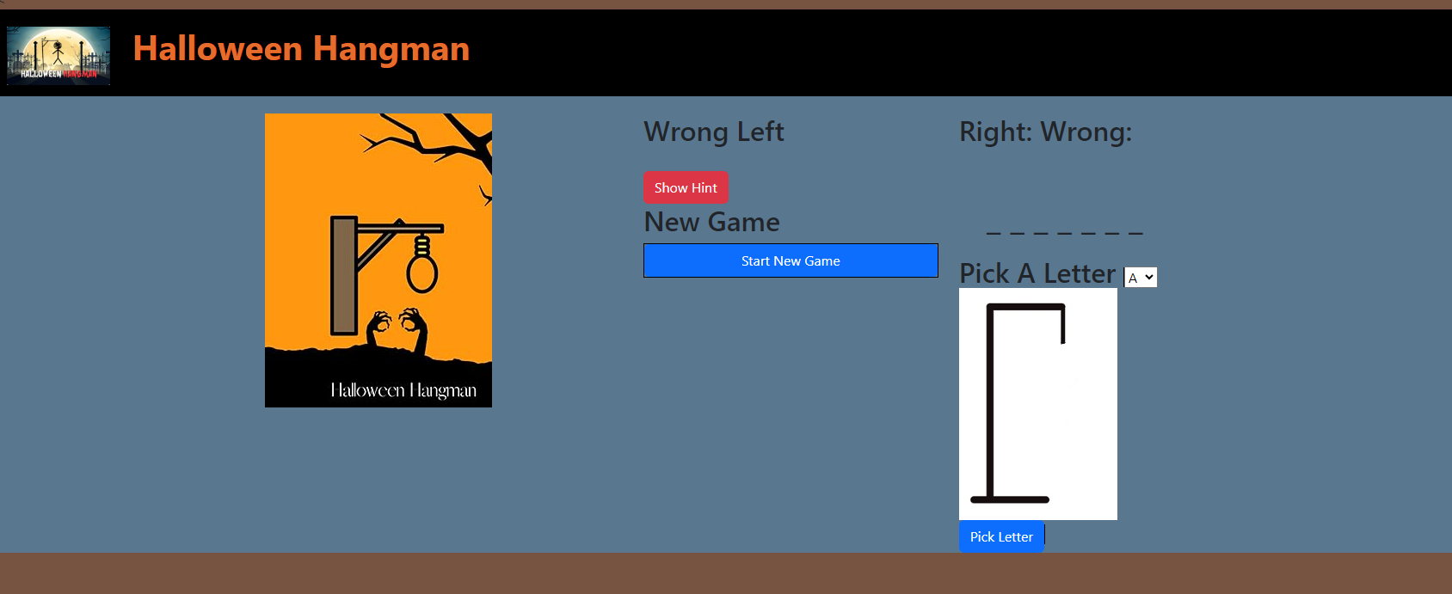
Out t
Overall Problem: Using bootstrap, node.js and express and handlebars build Halloween Hangman
R1 – Create a route to the following layout with
R1.1 – This banner with the logo, words in orange about 10 px from image
R.1.2 Use similar Halloween colors
R.1.3 Use a bootstrap layout to place image on left, then these buttons then this gameplay area
Note: all needed images are supplied on brightspace

Slide 2
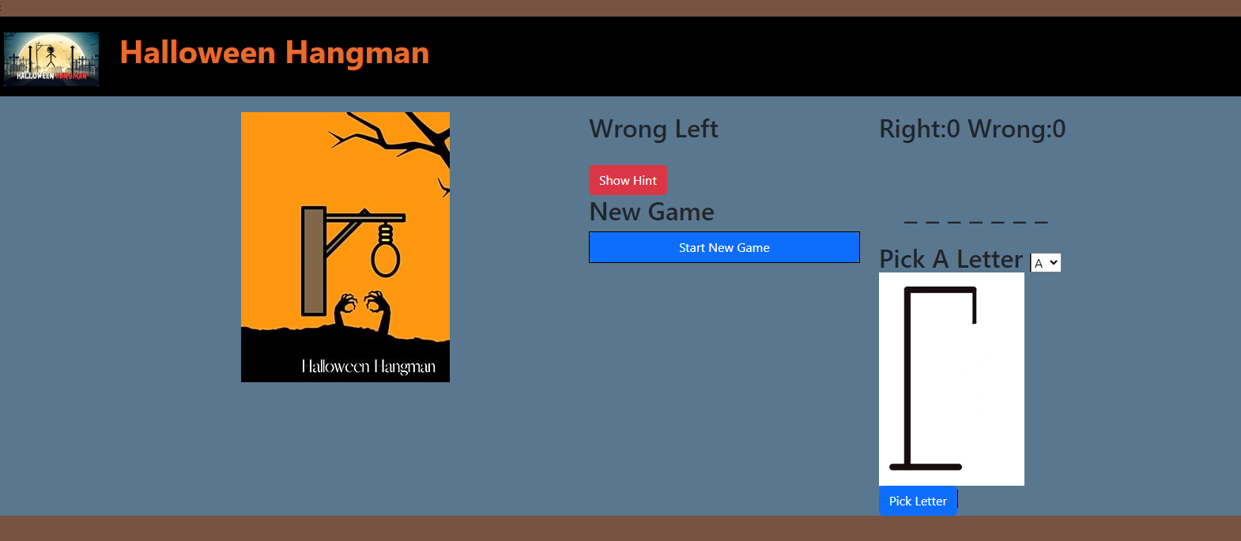
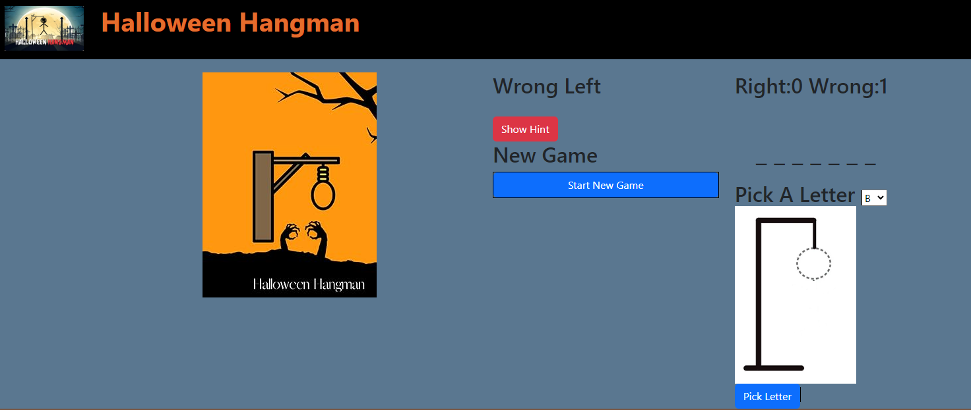
R2 –
R2.1 – Support a drop down with letters A-Z.
R2.2 – Show the Right and Wrong count.
R2.3 – Each wrong guess will update the count here and show the next image. E.g., I guessed “A”
Wrong gets updated and next image is shown
R2.4 – Remove the guess letter from the Pick A Letter Dropdown (E.g., here “A” has been removed since it was guessed)
2.5 - Use a Halloween color pallete - https://ankiewicz.com/color/palette/e66c2c

Slide 3
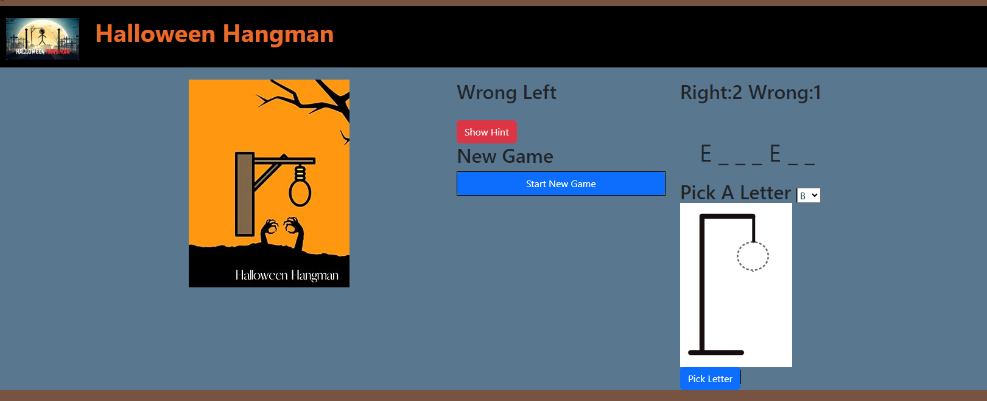
R3– Correct Guess
R3.1 – A correct guess increments the Right Count, but does not advance the hangman image
R3.2 – The Letter “E” is still removed from the available letters in “Pick A Letter”
R3.3 – The “E” is shown in its proper place in the word shown

Slide 4
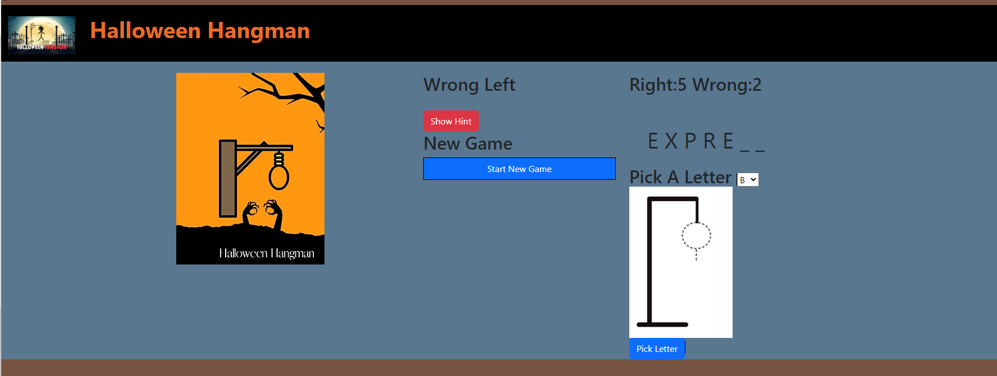
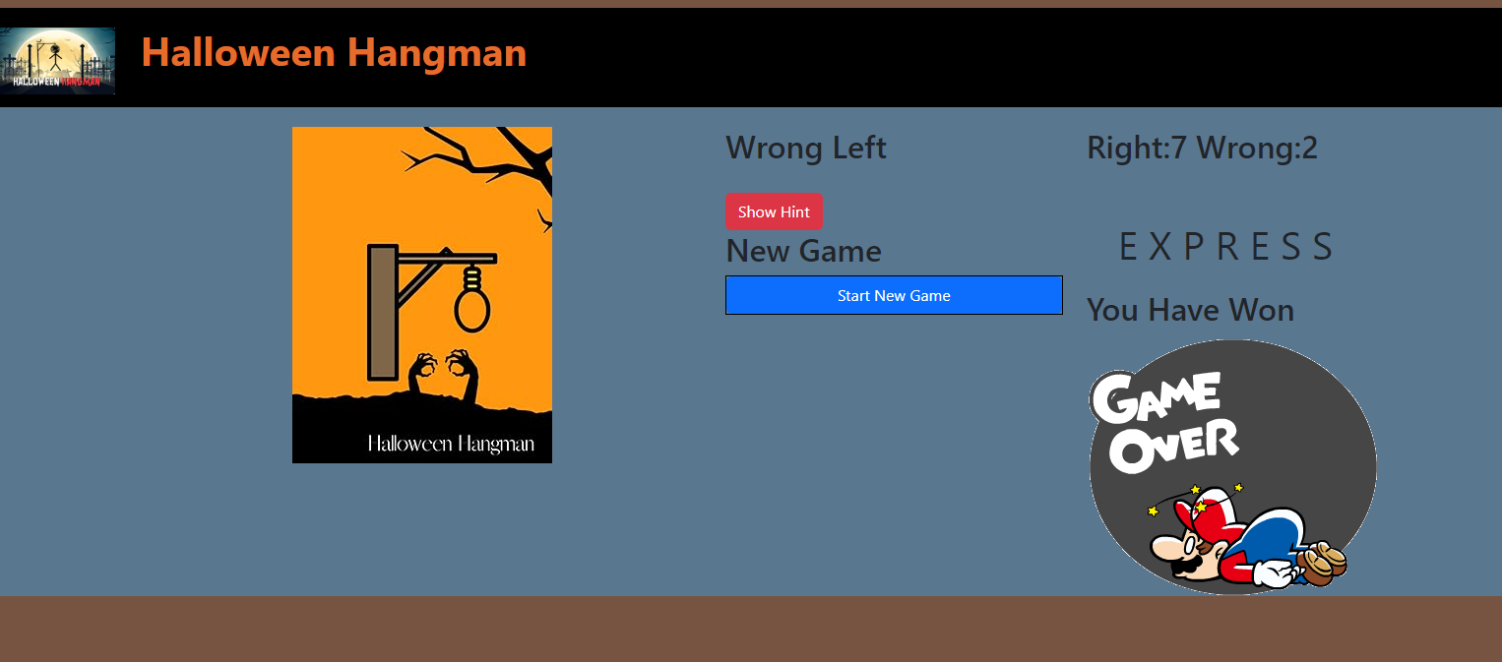
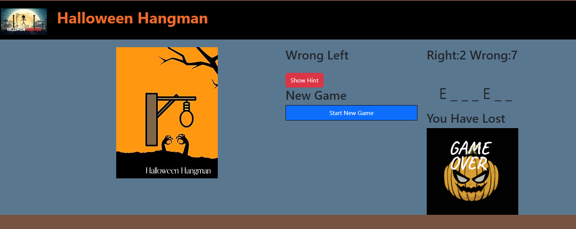
R4 – Game Play
R4.1 – Continue game play until there is a winner or loser keeping the right/wrong count and removing spent letters
R4.2 – On win … show a winning image and indicate “You Have Won” and remove the pick a letter
R4.3 – On Loss Show “You Have Lost” and Loss image and remove pick a letter.
R4.4. – Allow the user to start a new game. Now or anytime click this button

Slide 5
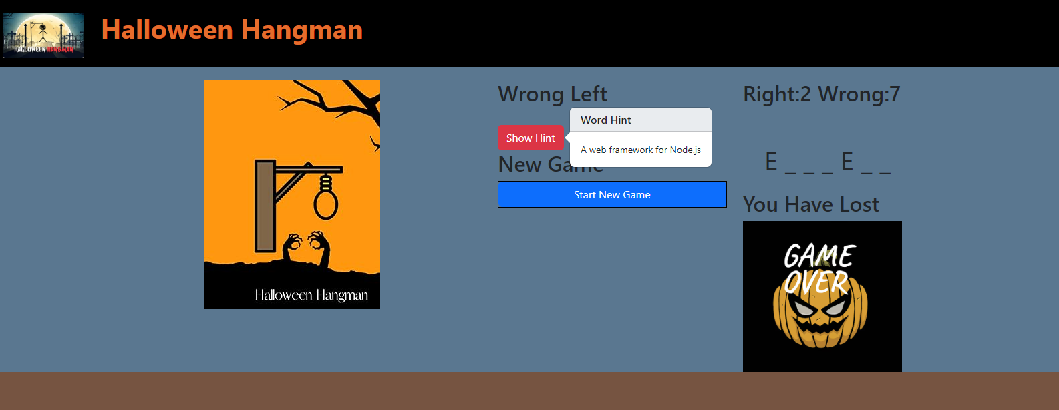
R5 – Enhance your game
R5.1 – Build an enhancement or 2. Here I used a Show Hint functionality. Here I use popovers from bootstrap.
I read about them in the bootstrap documentation and found an example here: https://www.w3schools.com/bootstrap/bootstrap_popover.asp ... Be careful since need to include a boostrap CSS with popovers (ask me if you don’t understand)

Slide 6
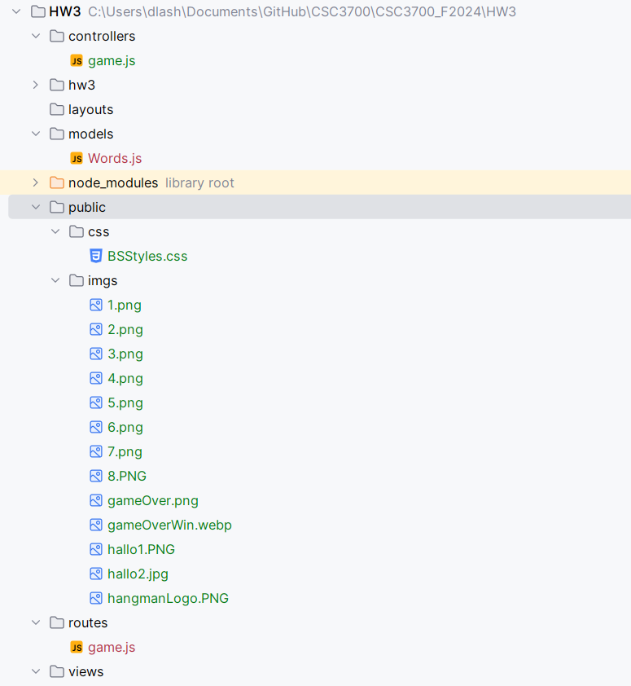
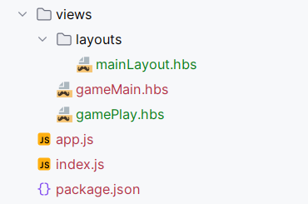
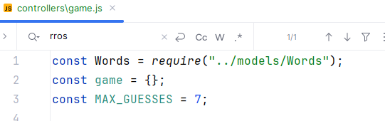
Special hints
You will need a bunch of files to get this to work in node.js/express
Here are a few hints
Use the Words.js provided. Make that a Model. It has a method to randomly retrieve a word.
Don’t use a game model. Instead make game an object global to game.js controller. You must use a game.js controller
Place all your css under public/css and images inside public/imgs. Note there are 8 images. Each one shows a different hangman ‘state’
You will need routes/game.js
You will also need to use hbs with a template to make it work
Make your main entry point app.js
DO NOT WAIT TO START. There is a fair amount to do here.
I started with the same zip file I provided for the midterm. It gave be a basic project quickly and then I added/removed what I needed

Slide 7
What to hand in
R6 - What to upload
R6.1. Zip all of your files together and submit a zip file. DO NOT INCLUDE THE node_modules directory
R6.2 Include a word document that contains the following:
R6.2.1 – 1 paragraph that describes what you got done
another short paragraph indicating what you did not get done. If you got everything done clearly indicate that AND describe an enahcement or 2 you might like to do
R6.3 – Include screen shots that show WITH THESE HEADERS ABOVE THE IMAGES
- Guessing right letter
- Guessing wrong letter
- Winning the game
- Losing the Game
- Initial game start

